Slide 1
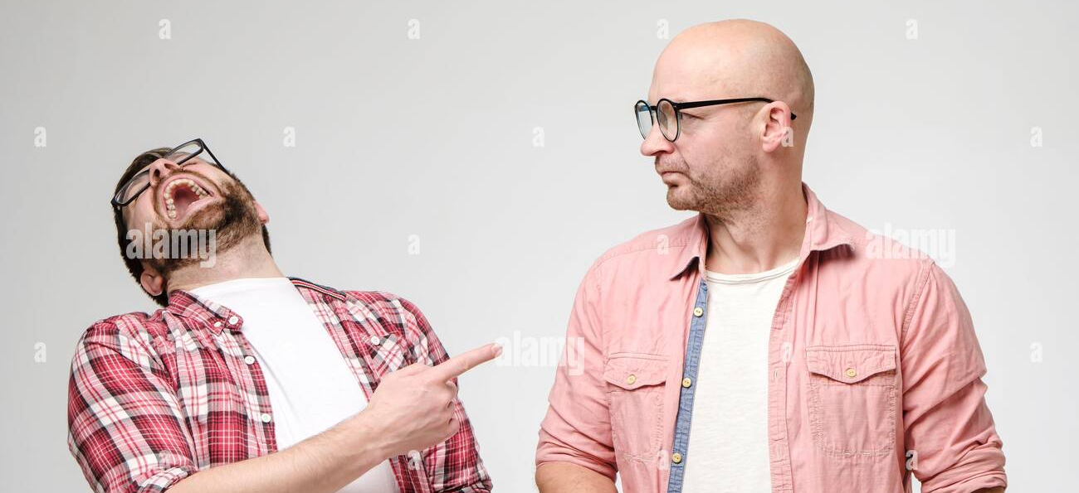
Quarrels and cracks
On the Values of Comic Distraction
David Shoemaker
Cornell University

Slide 2
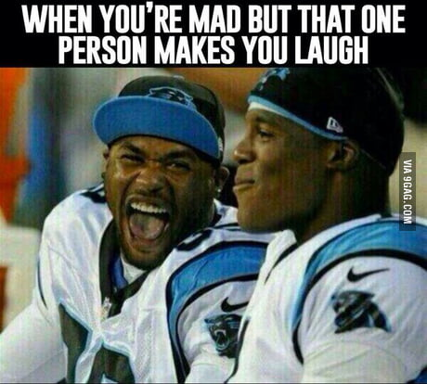

Slide 3
If your attitude towards someone is wholly objective, then though you may fight him, you cannot quarrel with him, and though you may talk to him, even negotiate with him, you cannot reason with him. You can at most pretend to quarrel, or to reason, with him.
Peter Strawson
Notes:
Quarreling requires interpersonal engagement, in remaining vulnerable to the reactive attitudes, of a kind of engaged resentment, love, and forgiveness.

Slide 4
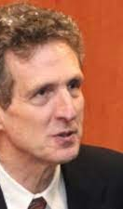
When two people are quarreling, one of the first things they stop doing together is laughing; they refuse to laugh at each other’s attempts at humor…. As soon as they begin to laugh once more, we know that the end of the quarrel is at hand.
John Morreall
Notes:
Now what are the attempts at humor here? They aren’t jokes: “Hey, did you hear the one about the priest, the rabbi, and the duck?” They are instead wisecracks, and it’s worth saying a bit about what those are.

Slide 5
Puzzling questions
Quarrels and amusement both require the participant stance (why and how?).
yet they are mutually exclusive (how and Why?).
Notes:
That’s what this talk is about.

Slide 6
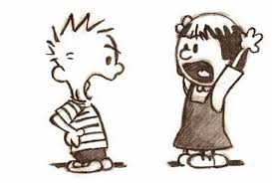
PART I QUARRELS

Slide 7
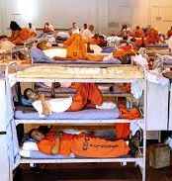
Objective vs. participant stance
Notes:
The difference: One involves seeing others as objects of social policy, to be managed, handled, cured, or trained. The other involves a range of reactive feelings and attitudes we are vulnerable to only within our interpersonal relationships, e.g., resentment, gratitude, forgiveness, anger, and love.

Slide 8
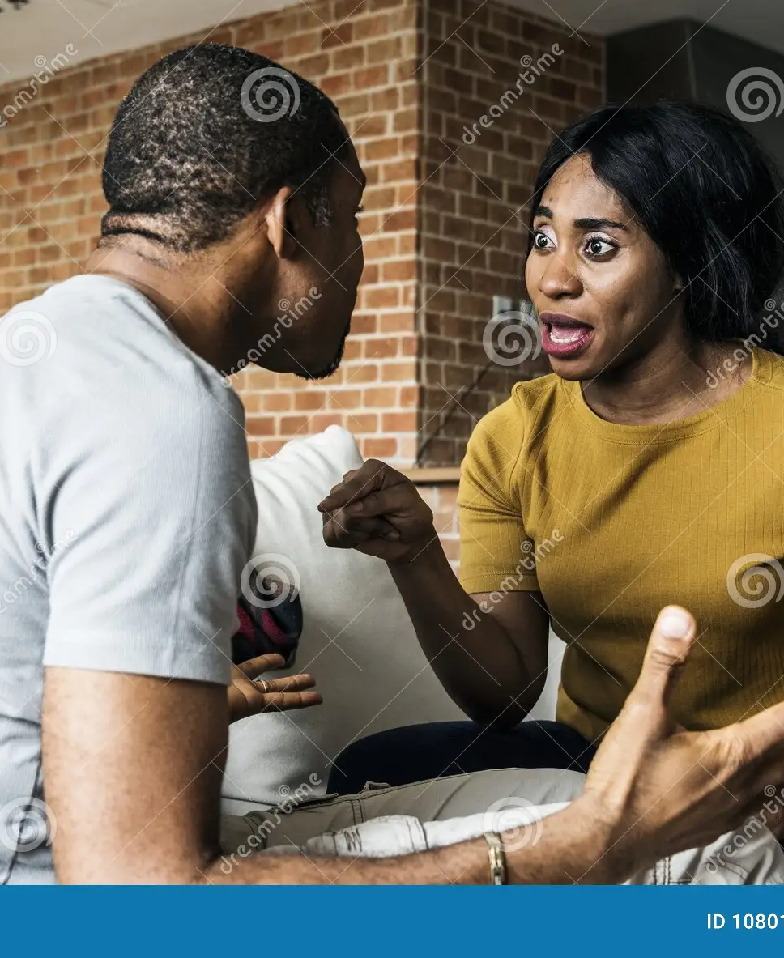
Quarreling: what is it?
a type of disagreement consisting in sharp-edged exchanges of reasons.
Notes:
The sharpness of the edge here consists in anger.

Slide 9
Anger (resentment/indignation)
a Response to what we take to be of “very great importance,” namely, the “attitudes and intentions towards us of other human beings,” of “how much we actually mind, how much it matters to us, whether the actions of other people—and particularly of some other people—reflect attitudes towards us of goodwill, affection, or esteem…or contempt, indifference, or malevolence…” (i.e., quality of will) (p. f. strawson).

Slide 10
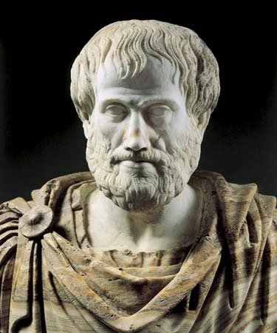
Aristotelian anger aim
Anger is “an impulse, accompanied by pain, to a conspicuous revenge for a conspicuous slight directed without justification towards what concerns oneself or towards what concerns one’s friends.”
(Rhetoric, Book 2, Ch. 1)

Slide 11
Anger’s actual Aim
Assumption by most: it aims at retaliation.
No—it actually aims at confrontation-Communication.

Slide 12
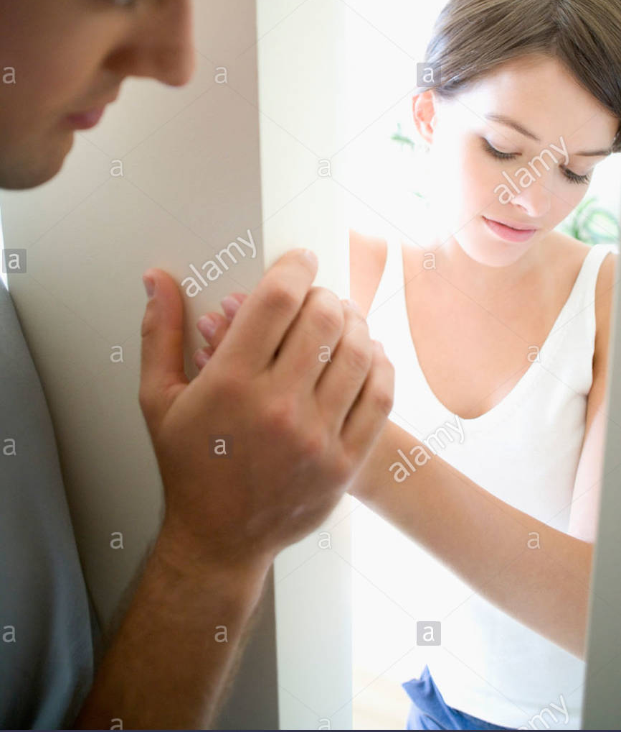
anger w/o Retaliation

Slide 13
anger w/o Retaliation

Slide 14
anger w/o Retaliation (yet)
Notes:
Chair ignores your voice (as woman).

Slide 16
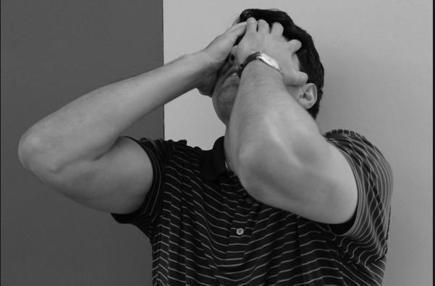
anger’s aim
to (dramatically) communicate a demand for acknowledgment of how offender made offended feel
this demand is successfully met (and aptly dissolved) by simpatico painful experience (remorse)
Notes:
Talk about psychopaths, perhaps some with autism.

Slide 17
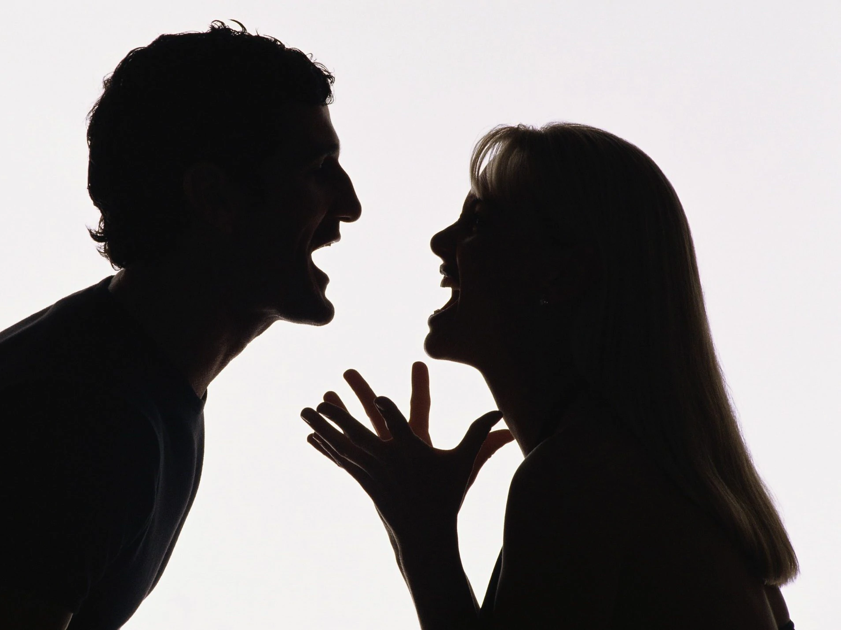
Quarrels and anger
(vulnerability to) anger is what’s unique to (and presupposed by) quarrels, triggered by perceived ill will in reason-exchanges.
Quarrels (and participant stance generally) thus require capacity for, and exercise of, empathy.
Best explanation of why those who are impaired or incapable of empathy are thereby excluded
Notes:
When you’re having a dispute, it can turn into a quarrel once people start suspecting the motives of the person they’re arguing with, and when truculence, obstinance, willful ignorance, and deceit enter the mix, so does agential anger.

Slide 19
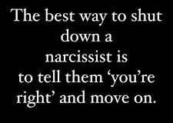
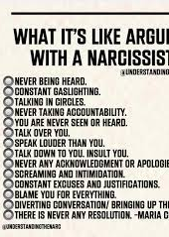
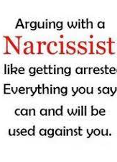
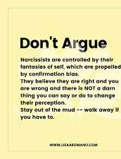

Slide 20
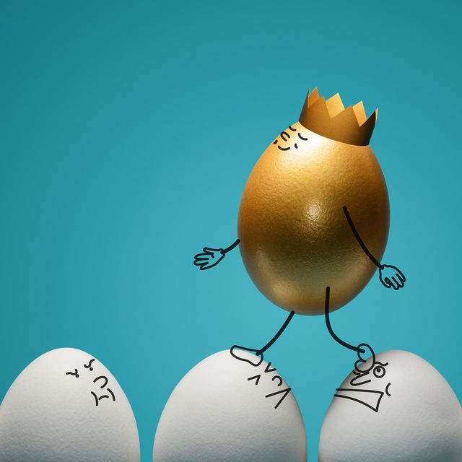
Narcissist argument tactics
Never admit fault
deflect and project
Gaslight
play the victim
devalue the other
This is not quarreling. why not?
Aims at manipulation, not empathic engagement or vulnerability to being persuaded or wrong.
Narcissists are properly viewed from objective, not participant, stance. (You can’t quarrel with a narcissist. Just walk away!!)
Notes:
Narcissists are one member of the Dark Triad where there’s been a lot of study on how they argue. It’s not pretty. Any humor they use is aggressive, and it tends to keep the argument going (unless you have the equanimity to walk away from it). All psychologists strongly urge you to walk away from fights with narcissists, which you cannot win. The empathy needed here is to take up the other person’s perspective, to see things as she does, as valuable, as worth pursuing, as well as being emotionally vulnerable to her setbacks.

Slide 21
Ending quarrels (in a mutually satisfying way)
via resolution: Can be achieved by mutual acknowledgment of relevant reasons, their relative weight, what’s best all-things-considered, etc. (the reasons route)
Via Dissolution (the comic route)
Notes:
Dissolution can occur from adventious distractions: smoke alarm, dog vomits, phone call from distressed daughter. I’m interested in another way, one that we can control.

Slide 22
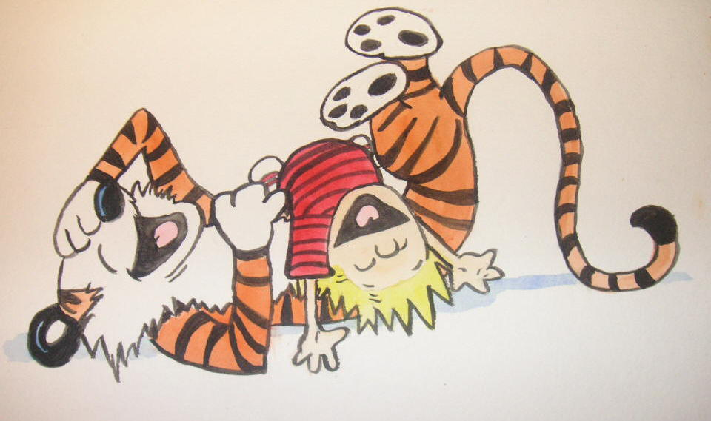
Part II Cracks

Slide 23
Jokes vs. WISECRACKS
JOKES ARE CANNED/WISECRACKS IMPROVISED
JOKES ARE MONOLOGICAL/WISECRACKS CONVERSATIONAL
JOKES YOU SEE COMING/WISECRACKS YOU OFTEN DON’T
JOKES ARE TOLD or performed/WISECRACKS ARE MADE
JOKES ARE SOLO/WISECRACKS ARE INTERPERSONAL
WISECRACKS: IMPROVISED, SPONTANEOUS WIT BETWEEN PEOPLE. Includes LEG-PULLING, PRANKS, MOCKERY, TEASING, BANTER, BALL-BUSTING, IMPERSONATIONS, STEREOTYPING, EXAGGERATED ANECDOTES, callbacks….
Notes:
It’s the interpersonal nature of wisecracks that raises moral concerns, for wisecracks are ways of treating and dealing with other people: friends, family, co-workers, and even enemies.

Slide 24
What makes things funny?
A Vexed question
Relief/release?
Superiority?
Incongruity?
Incongruity-resolution?
Play?
Absurdity?
All of these and more!

Slide 25
values of wisecracking
Fun! brings people together
invites sympathy for shared travails/bonding
enables coping
Reduces uncertainty and social distance, increases cooperation
Reinforces/maintains social norms and group boundaries
Tests and alters relationships for the better
To get these valuable goodies, though, you must engage in the right sorts of humor.
Notes:
Frances Hutcheson: “Men have been laughed out of faults that a sermon could not reform.” I of course don’t deny that there are disvalues too, including how it draws boundaries between “us” and “them,” reinforces hierarchy, stings, and more. But I’m going to stress the positive values today.

Slide 26
Humor Styles
Affiliative
Self-enhancing
Self-defeating
Aggressive
Notes:
The values of wisecracking are generated pretty much only by the positive forms.

Slide 27
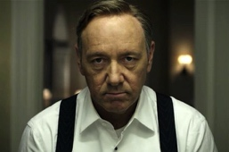
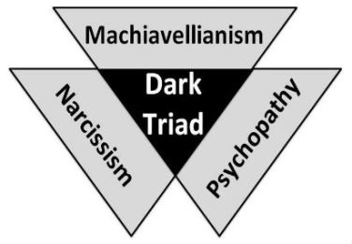
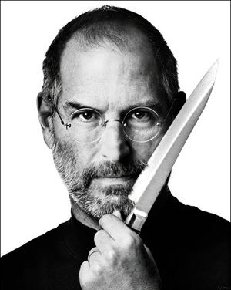
The Dark Triad: Humor Styles
Studied together insofar as they are manipulative and callous
Humor style: Only aggressive (schadenfreude)
Bad senses of humor
Notes:
Why bad sense of humor? they see no reason not to engage in the meanest forms of aggressive humor, and they see no value in the mutuality of affiliative humor or the sympathetic bonding generated by self-deprecating humor.

Slide 28
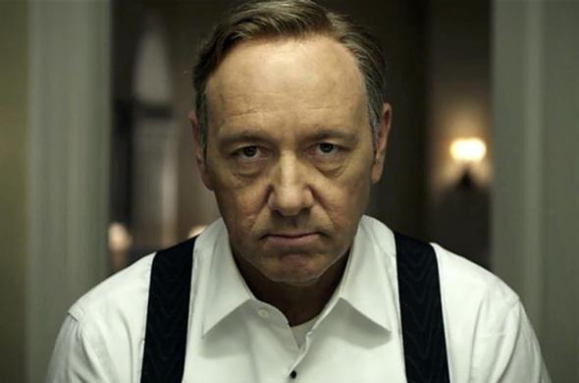
Dark Triad mistakes
Seeing “reasons” for amusement that don’t exist
Not seeing reasons for amusement that do exist.
Source: empathic impairments

Slide 29
Narcissist argument tactics
Never admit fault
deflect and project
Gaslight
play the victim
devalue the other
use Highly aggressive humor (sarcasm, mincing mockery)
Notes:
A reminder and an addition

Slide 30
Summary thus far
Quarreling and Valuable Wisecracking require the same capacity to take up the participant stance: empathy
If both require empathy, why are they mutually exclusive?

Slide 31
Quarrel-ending humor (I)
What we know doesn’t work: Aggressive or self-defeating humor.
“Affiliative humor was systematically related to positive observer-rated partner responses (more laughter, less anger, and greater satisfaction with the conflict resolution)…. individuals who used it more were also more satisfied with the conflict resolution themselves.”

Slide 32
Examples?
Notes:
The psychological research doesn’t provide any examples. Here are some possibilities.

Slide 33
what couldn’t be studied
Self-enhancing humor
what is it?
Is it interpersonal?
(how) might it contribute to ending quarrels as well?
Notes:
Couldn’t be studied because motivations difficult to perceive or operationalize.

Slide 34
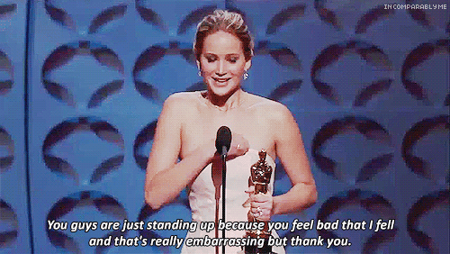
Self-enhancing humor
What is it? A way of responding with humor to life’s curveballs
Self-deprecation
Notes:
Jon Stewart and Jennifer Lawrence. But there’s another example of self-enhancing humor, exemplified in the following shot

Slide 35
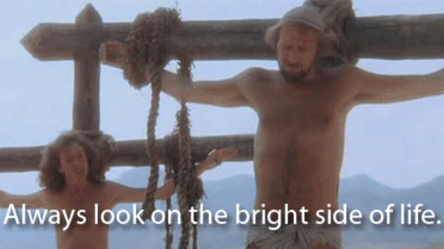
Notes:
There’s a distinctive and powerful kind of self-enhancing humor I want to investigate, and we see it hilariously displayed here.

Slide 36
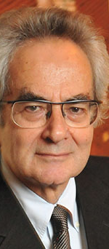
The absurd
Thomas Nagel
the absurdity in life: “a conspicuous discrepancy between pretension or aspiration and reality.”
The absurdity of life: “arises when we perceive…an inflated pretension or aspiration which is inseparable from the continuation of human life and which makes its absurdity inescapable, short of escape from life itself.”
Notes:
Both kinds matter for our project. But first, let’s explore the Grand Conception

Slide 37
The engaged perspective
Notes:
We find ourselves in a world where we perceive and embrace various values, and those values provide us with the reasons we have to do whatever we do. The things we take seriously, the things we value and the life projects we pursue, actually matter, full stop, that they are fully justified, secure, deeply grounded, and worth pursuing.

Slide 38
The Reflective Perspective (the step-back move)
Notes:
However, we also have built into our human nature a very special capacity, an ability to reflect on ourselves, on our projects and values. We thus have the option to take up a distinctive perspective on our lives, to take what I’ll call the step-back move of self-consciousness. This is to see ourselves from outside of ourselves, by taking up a viewpoint that can pull the rug out from under our engaged, valuing, lived-in perspective. While we are in the throes of our projects and pursuits, we think we are fully justified in pursuing them: They are things worthy of pursuit, they truly matter, and they’re on secure foundations. Call this the engaged perspective. But when we take the reflective perspective, we step back and look at our lives from the perspective of the universe, as it were, to see that we are embedded in a very specific and local time and place, with highly contingent features: built in a certain bio-psychological way, born into a particular family and society, indoctrinated and educated in highly contingent ways, and constructed as a kind of clockwork machine in a universe of cause and effect. Once we step back and recognize these facts about ourselves, we can also then see that our reasons for pursuing our particular projects—as opposed to what could easily have been a wildly different set of projects—are woefully fragile, dubitable, possibly without any true foundation at all. They are borne of commitments and ways of thinking and reasoning that are given to us with our specific construction and station in life, but they themselves have mostly gone unquestioned, and so may well seem shaky or groundless under any kind of reflective critical examination.

Slide 39
The absurdity of life: Global Version
vast discrepancy between our inflated pretentions of worth and the possibility our projects are pointless.
We have to live by ignoring our doubts, but doubts remain unsettling.
“may be both sobering and comical” (Nagel)

Slide 40
How to find the comedy
Depends on where you focus your attention.
Focus on lack of foundation for life projects = sobriety
Focus on disparity between lofty ideals and lowly reality = comedy
Notes:
A talk on dignity. He’ll be horrified, if he focuses on his own lack of dignity. He can be amused (with everyone else) if he focuses on the irony, the absurdity of giving a speech on such high-brown ideas in such a low-brow way. And that’s funny.

Slide 41
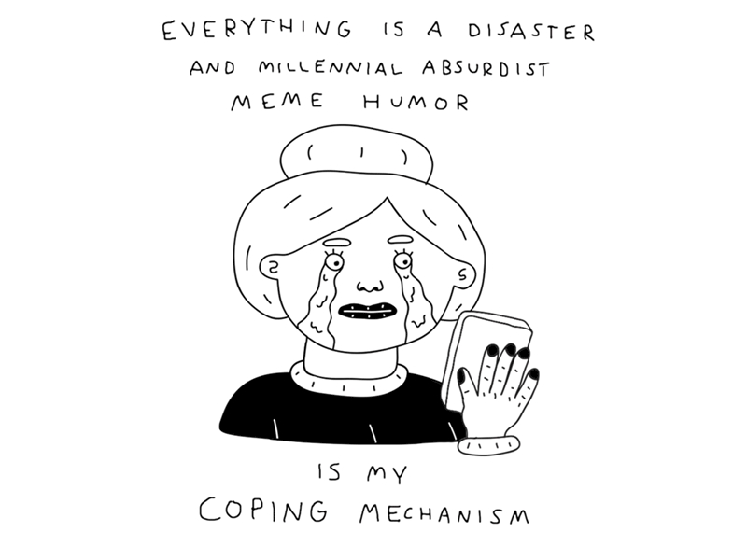
Absurdity in life: Local version
Step-back from some values/ends, while holding fast to others.
Notice disparity between pretensions and reality in limited domains
And yet: Why do it?

Slide 42
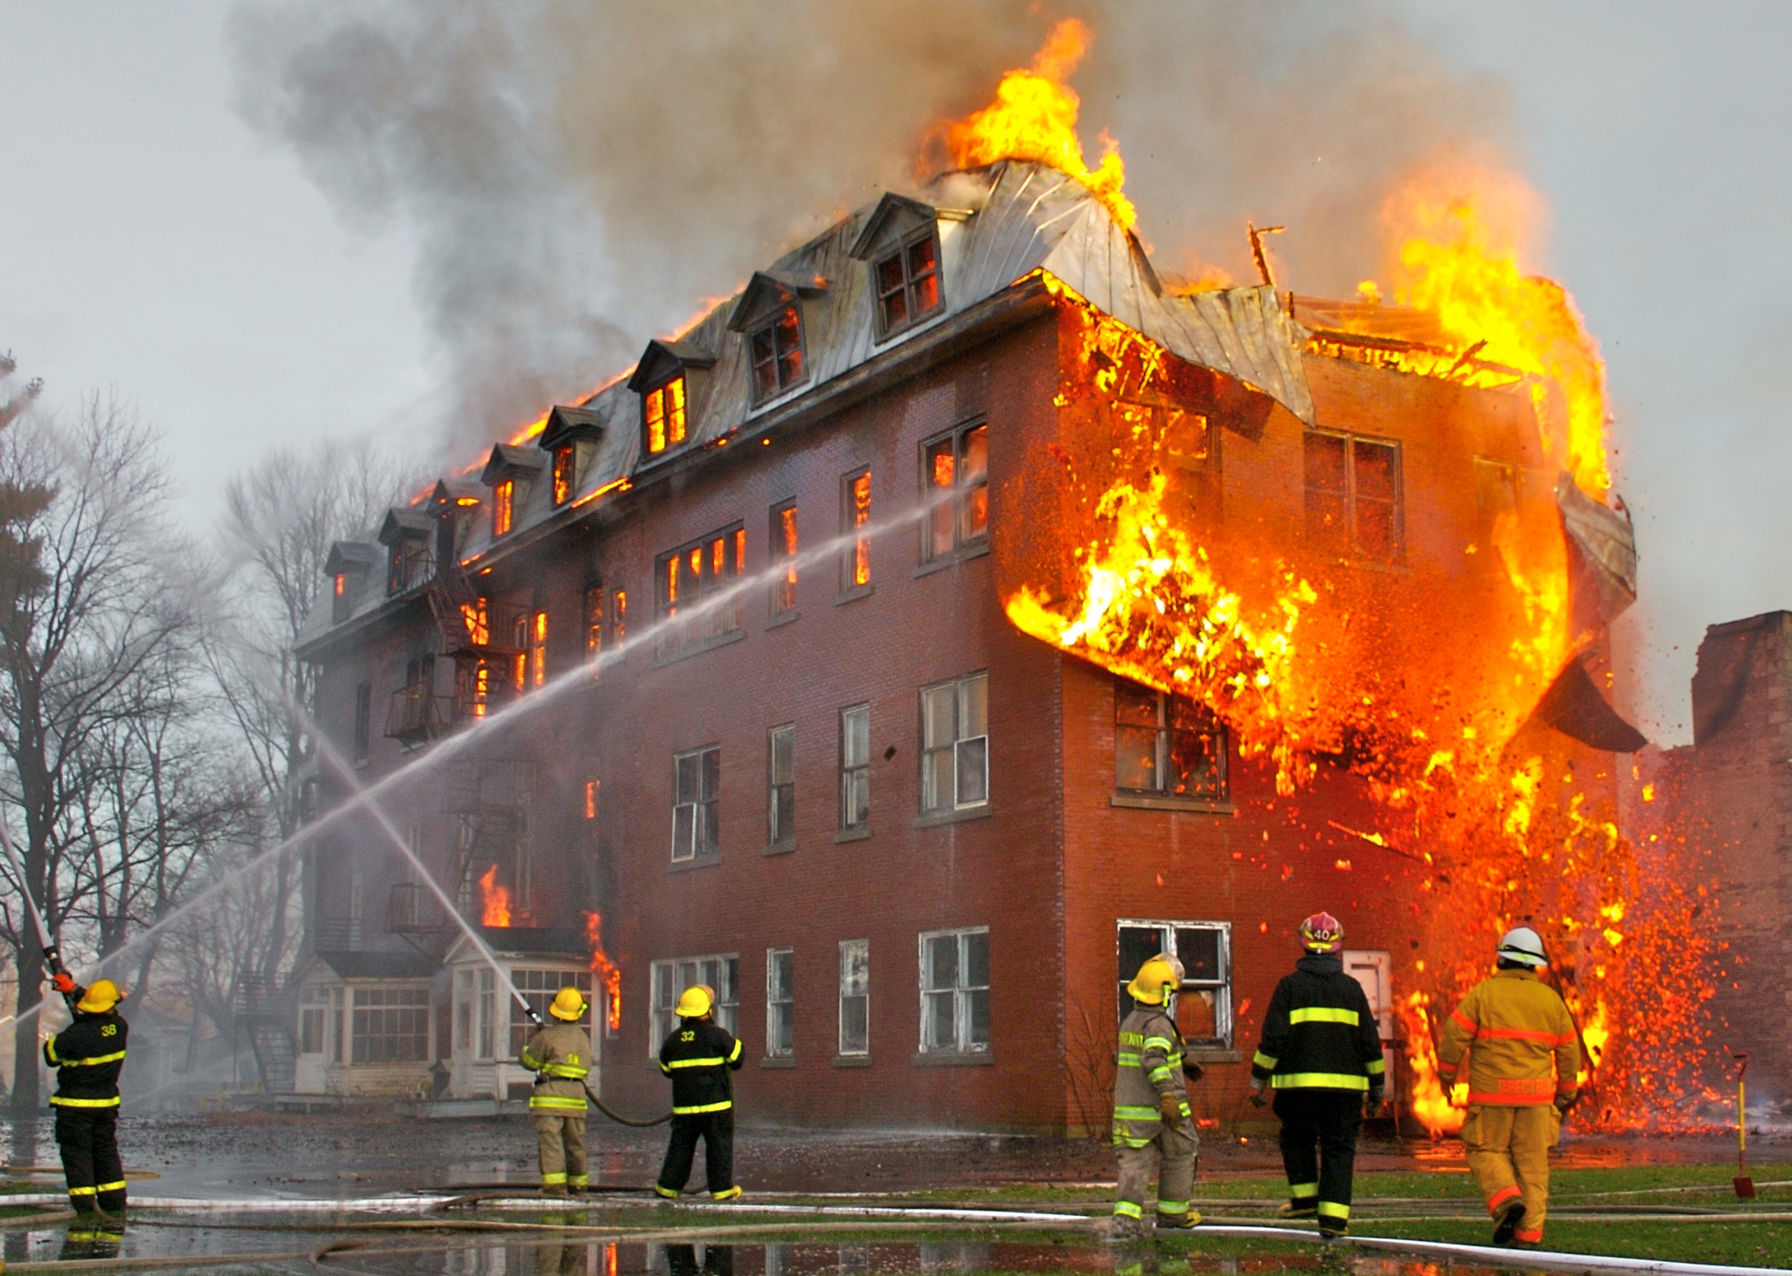
Notes:
Their morbid senses of humor, as it turns out, enable them to cope with, and gain some psychological control over, the ongoing miseries and tragedies they have to deal with on a regular basis, which might otherwise emotionally overwhelm them. To go about their business with a grim seriousness, fully emotionally engaged with their charges and responding as many of the rest of us would—with severe distress—to every single killing and maiming they experience would prevent them from doing their jobs, and it would likely psychologically break them.

Slide 43
The coping benefits of morbid humor
Moderates stress and physical symptoms
Reduces anxiety and distress more than physical exercise
Enables cognitive reappraisal of threats
Increases pain tolerance
Increases sense of self-esteem and optimism
Increases resilience

Slide 44
How?
Distract and detach
humor focusing attention on absurdity detaches from emotional distress, but not cognitive demands
Notes:
The first responders aren’t distracted from their cognitive demands: indeed, it enables them to focus on those without emotional distress, which enables them to do a better job. So it’s not just prudentially good, it’s morally good.

Slide 45
Emotions and appraisals
Most emotions appraise things that are taken to matter.
Fear appraises threats or dangers
Pride appraises splendid results with which we are associated
Disgust appraises infectious things
anger appraises slights (i.e., disrespect)

Slide 46
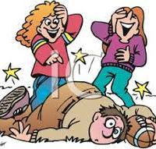
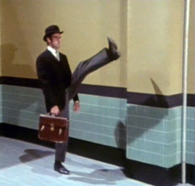
Amusement and Mattering
Amusement often appraises things as not mattering.
Absurdist humor, in particular, treats things as not mattering, and so as amusing.

Slide 47
How can we get there?
By taking off our empathic distress glasses
(and putting on our psychopath glasses)
Notes:
Perceiving the dubious nature of our values alone isn’t enough. That’s what’s sobering. It’s perceiving the disparity that matters. During the American Civil War, depressed soldiers were sometimes prescribed glasses with rose-colored tints. Seeing their world through “rose-colored glasses” significantly raised their spirits (thus the phrase). Today we know that a variety of colored tints on glasses have different effects on the moods and emotions of the people who wear them. Different tints produce different responses in people viewing the same pictures. We see all the same worldly properties, but we have different affective responses when viewing them through different colored lenses.

Slide 48
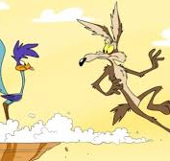
Notes:
Think about some distressful story you’ve got about yourself, some past pain. When you tell the story with distress, empathy calls for emotional distress and sympathy from those who hear it. But you can also tell the tale, as if you were a cartoon character, with great exaggeration. [Tell story of falling on ice.) It’s the exaggeration that highlights the absurdity, the disparity between pretension and reality. This invites from your truly empathic friends an emotional disengagement: they take off their distress glasses and put on their psychopath glasses for a while. And this enables the comedy: When you focus on the ridiculousness, the absurdity in and of our lives, you can see the silliness.

Slide 49
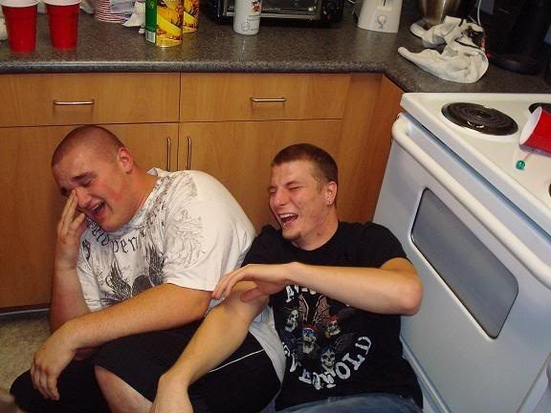
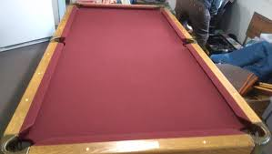
Notes:
“Tragilarious.” What can you do but laugh?

Slide 50
Empathy and morality
Sometimes true empathy requires (some) emotional disengagement.
Those who express only sympathetic compassion for others may thus be doing the immoral thing.
Notes:
When you wisecrack about your distress, you’re sometimes signaling to me that it’s OK to emotionally detach from your pain or trauma along with you. And this is what’s necessary for me to attend to the absurd disparity between your pretentions and reality, and so to find the funny in your pain. True kindness and caring, for example, occasionally require emotional detachment from the distressing pains of our actual fellows, so that we might revel together instead in the affiliative and bonding amusement that’s available to us once we focus on the absurdities of our lives. It may be that in our darkest hours all we want is to share some amusement with others at our plights, where actual kindness and empathy require the sputteringly uttered, “What can you do but laugh?!”

Slide 51
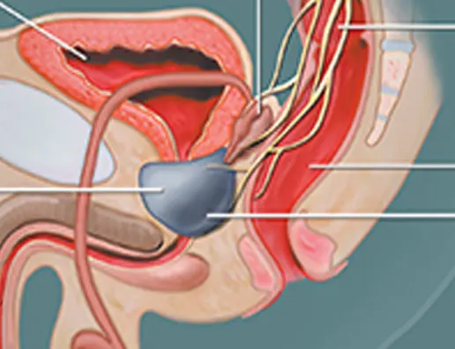
“Leave it to you to get the weakest, most treatable cancer there is.”
“C’mon out for a drink, you’re not dead yet.”
“That is a radical strategy to get a break from your administrative duties.”
Notes:
I’ve had to practice what I preach. This is my prostate (or an artist’s rendering thereof). It was cancer-riddled, so they cut it out of me. I could take a wee bit of sympathy when I told friends, but what I really craved were wisecracks. And I got ‘em. [CLICK THROUGH QUOTES] These people aren’t just assholes; they are my dearest asshole friends. And my gratitude for their emotionally detached wisecracks about my diagnosis was enormous. Just like my cancer-riddled prostate.

Slide 52
summary
can’t simultaneously be angered and amused by the same person in response to the same events.
anger is a function of the “very great importance” we attach “to the attitudes and intentions towards us of other human beings….” It demands empathic emotional distress.
Quarrels are over things we take to matter.
how to dissolve them via comic absurdity?
Notes:
The anger we feel can only be a function of the values or reasons we see as having been violated or ignored.

Slide 53
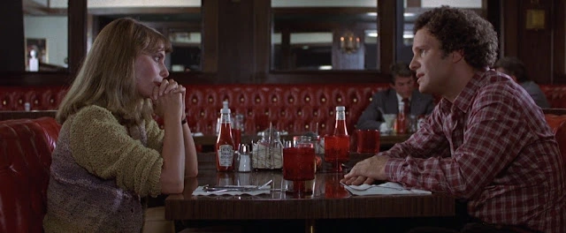
Robert: I don’t think that we should go out any more. Mary: Okay. It’s over again. Robert: No, not “again”. This is it. This is the last time. It’s for real. Mary: And you don’t love me? Robert: I do love you. I mean, love has nothing to do with this. Yes, I love you. I mean, that makes it very confusing, but I just don’t think… I mean… you’ve heard of a no-win situation, haven’t you? Mary: No. Robert: No? Really, no? You’ve never heard of one? Vietnam? This? I’m telling you they’re around. I think we’re in one of them.
Notes:
But we can distract and detach through an appeal to absurdist humor. An example of absurdist humor that could have, if only recognized as such by the couples, dissolve the quarrel.

Slide 54
The values of comic distraction
Enables recognition that the stuff we’re quarreling about may not matter so much.
distracts emotionally, but not cognitively, so doesn’t eliminate disagreement; it only dissolves the sharp edge (anger) from disagreement, enabling more productive focus on reasons-resolution.
successful quarrel-ending humor is tricky!
Notes:
involves getting quarreling partner to see just how little this particular dispute matters (emotionally). But, crucially, it should preserve our own and each others’ mattering to each other. But this final point is a topic for another day.

Slide 56
Available for preorder now!!

Slide 57
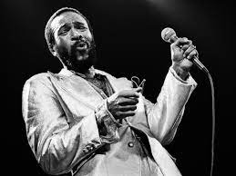
What’s Goin’ On?
Narcissists (and DT members generally) can’t engage in quarrels. Why?
Not vulnerable to agential anger, which demands perspective-taking and recognition of others’ ends from their point of view
can’t take up or be swayed by the sorts of reasons pressed upon them by others (which often reference those ends)
quarrels thus seem to require these minimal and mutual capacities:
Being vulnerable to agential-anger and its demands for perspective-taking and acknowledgment
To be open to considering and being swayed by the others’ values- and end-referencing reasons

